Slide 1
CaRL - Solving Catan using RL
Group members: Arrush Shah and Suraj Kidiyoor
5/20/2026
Syslab P3: Dr. Yilmaz

Slide 2
Problem
We want to make our own Catan bot using Reinforcement learning
Building an AI for Catan is difficult because of the many factors in the game
We want a flexible algorithm that can improve itself over time
Lack of current Catan algorithms publicly available
Notes:
Catan has many factors in the game, so it is difficult to make an algorithm that will find the best move every time

Slide 3
Background
What is Catan?
Victory Points (VP) are the goal of the game
Traditional game AI does not work well with unpredictable conditions
Reinforcement learning allows the AI to adapt
Notes:
Catan is a strategy board game where 2-4 players try their best to gain 10 victory points. Victory points can be obtained by building settlements and cities, or by performing special tasks like holding the longest road or having the largest army. The game is played in turns, in which each player rolls a dice to land on

Slide 4
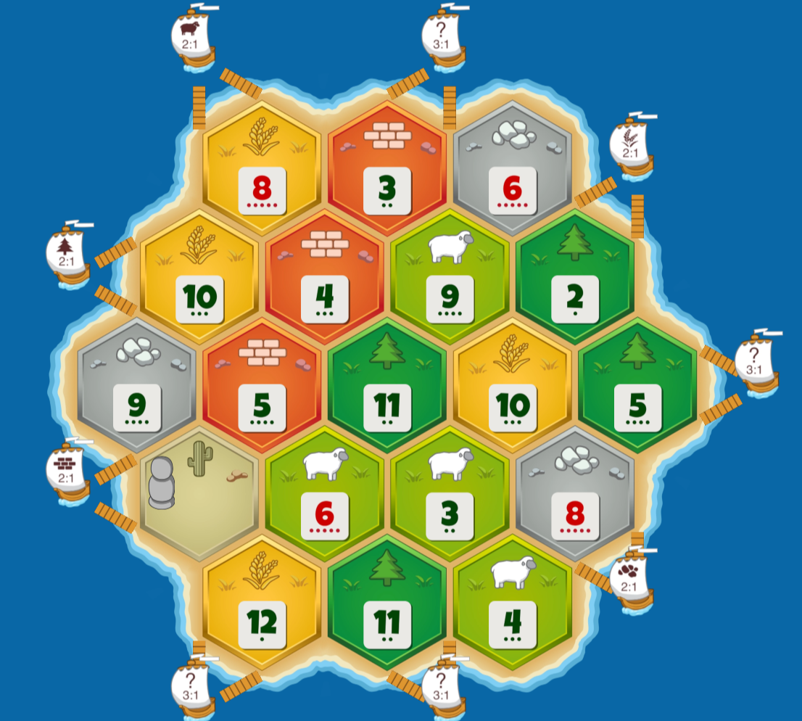
Starting Board
Figure 1: #5
Notes:
Catan is a strategy board game where 2-4 players try their best to gain 10 victory points. Victory points can be obtained by building settlements and cities, or by performing special tasks like holding the longest road or having the largest army. The game is played in turns, in which each player rolls a dice to land on

Slide 5
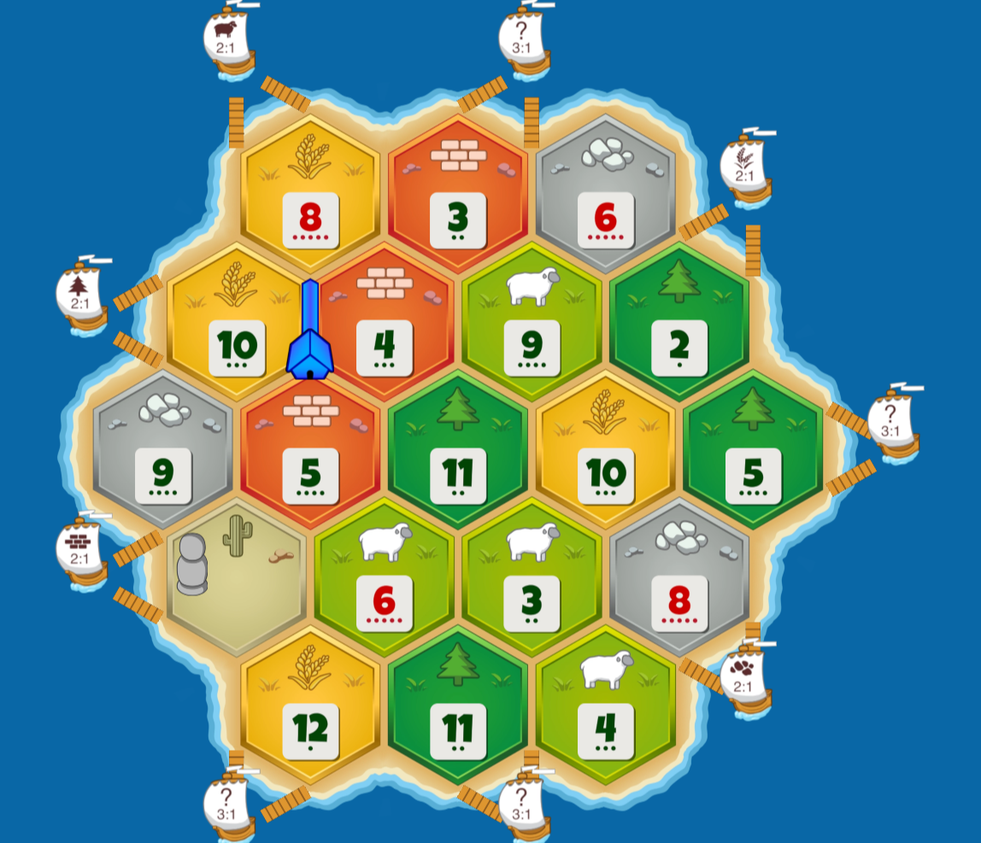
Setup/Starting
Figure 1: #5

Slide 6
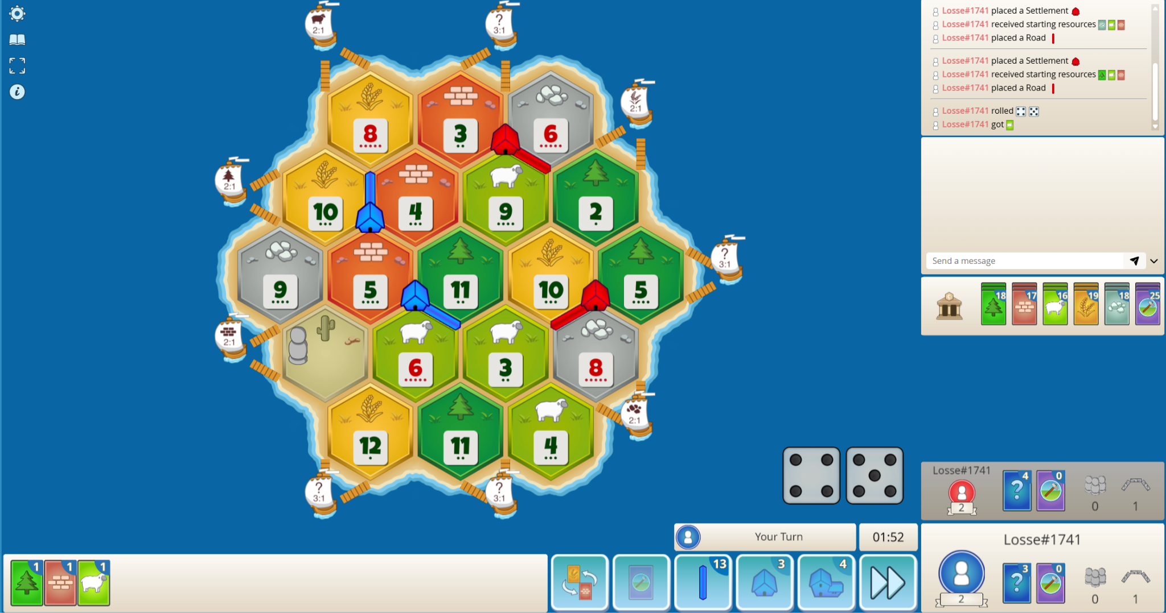
After setup phase is complete + First turn
Figure 1: #5

Slide 7
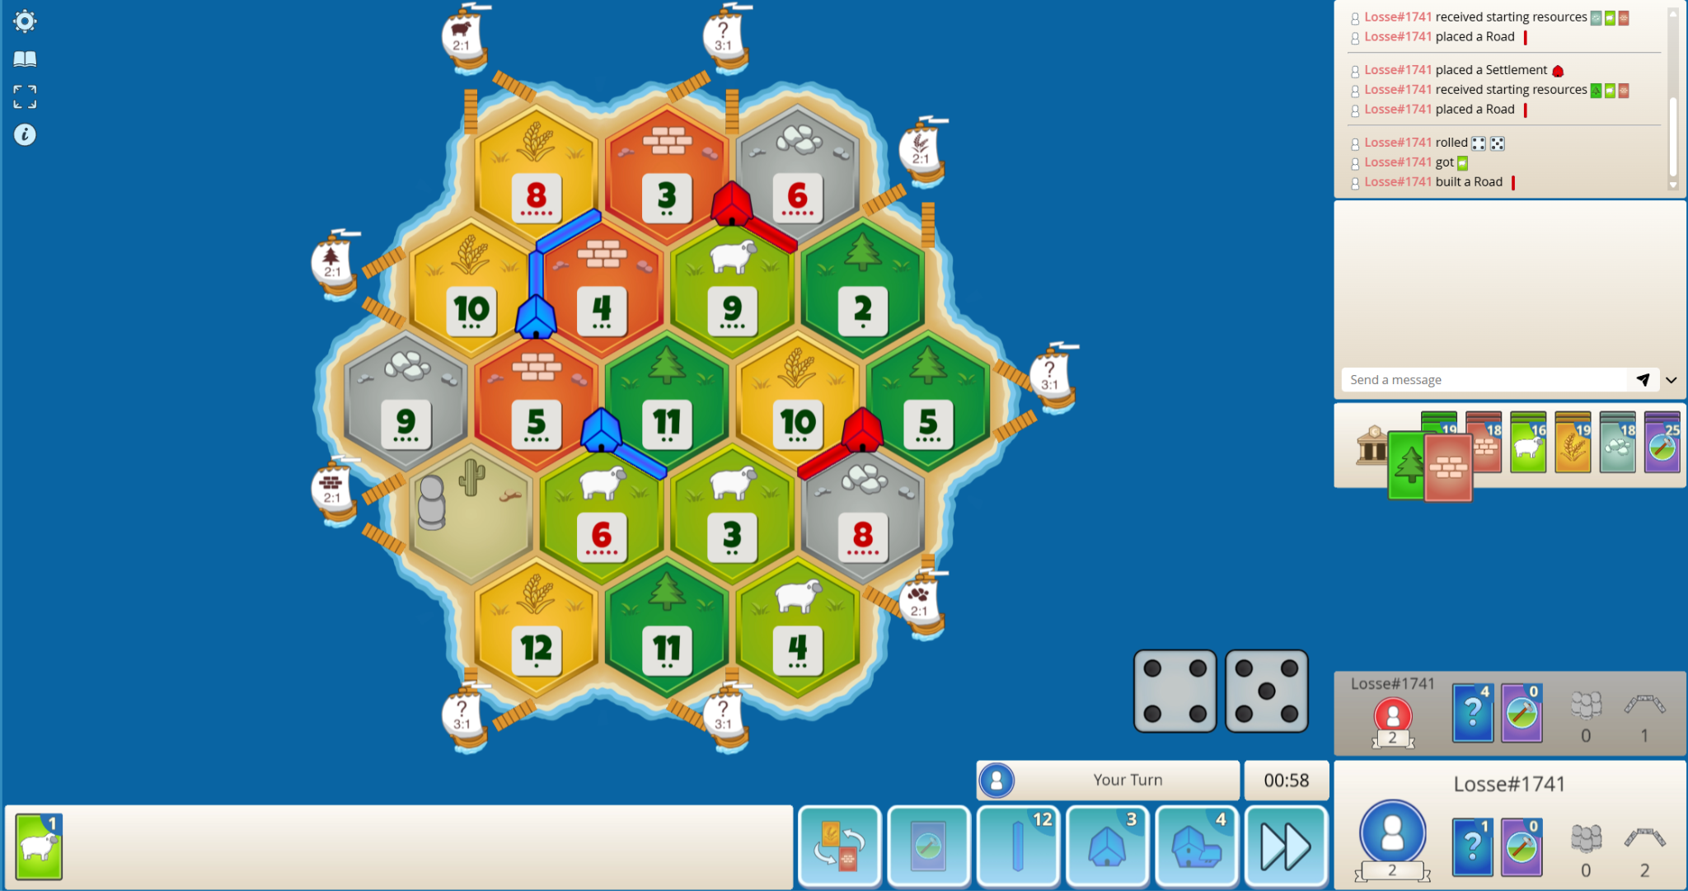
Building roads/settlements
Figure 1: #5

Slide 8
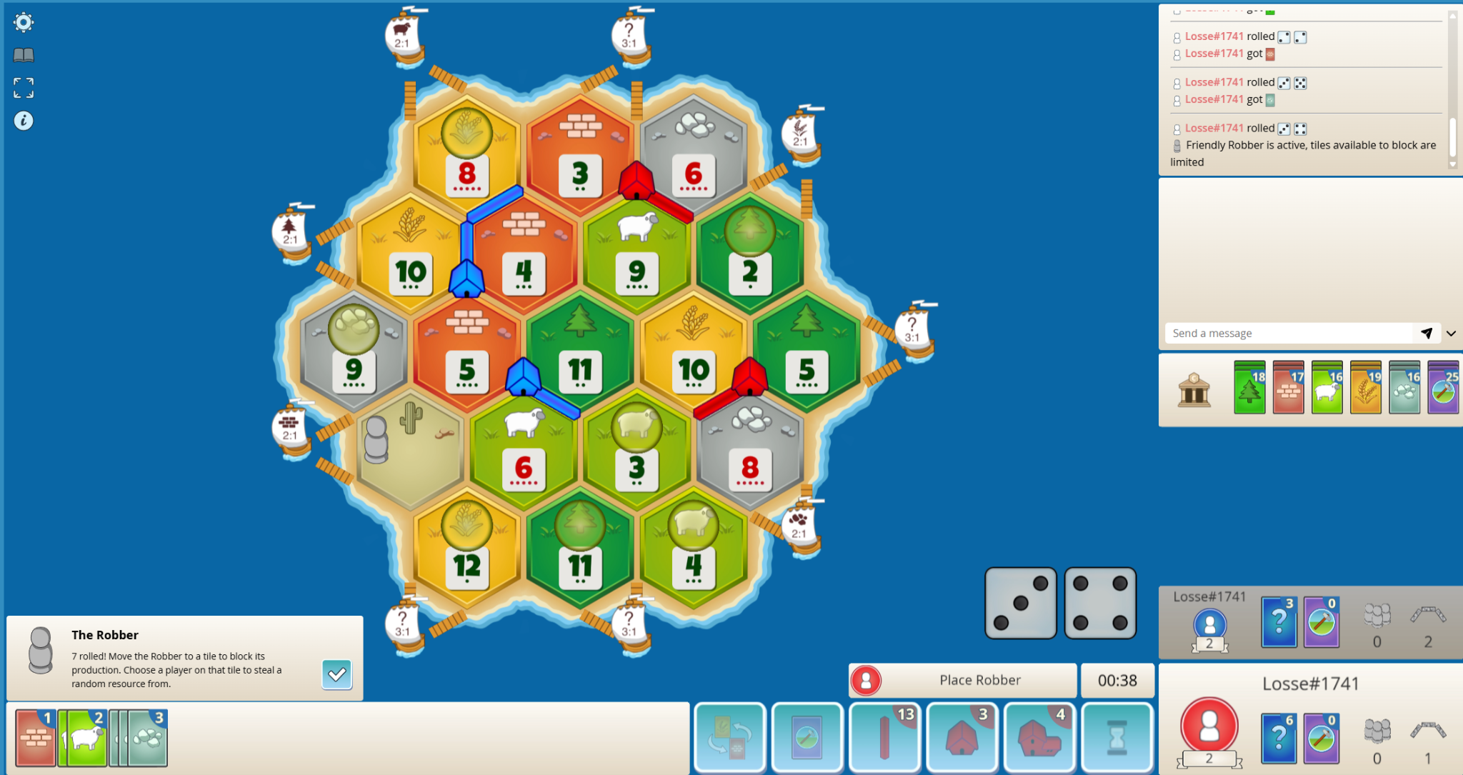
Rolling a 7, what is a robber?
Figure 1: #5

Slide 9
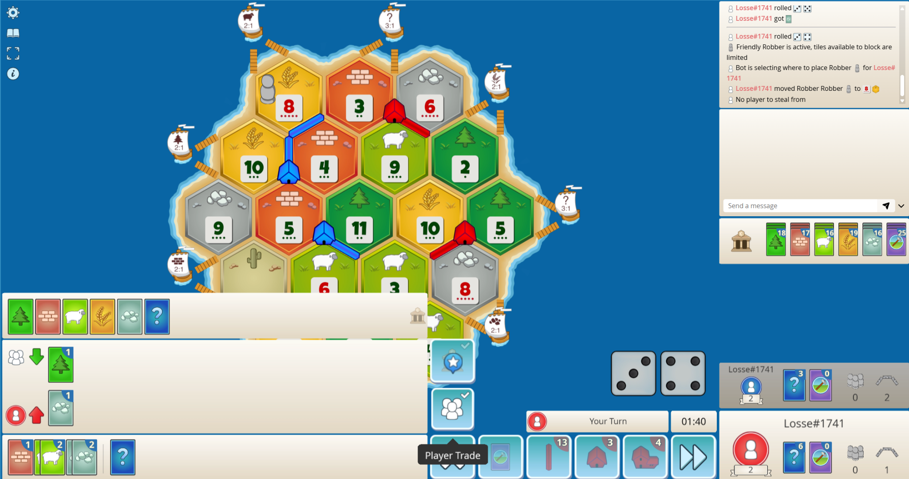
Trading
Figure 1: #5

Slide 10
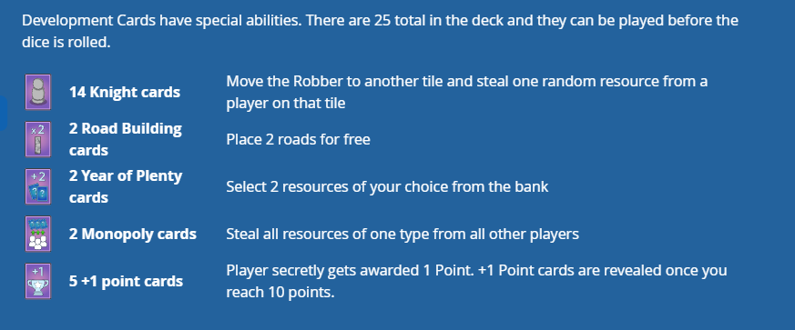
Development Cards
Figure 1: #5

Slide 11
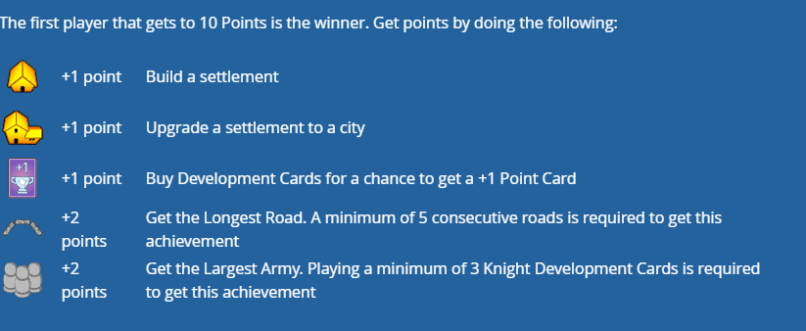
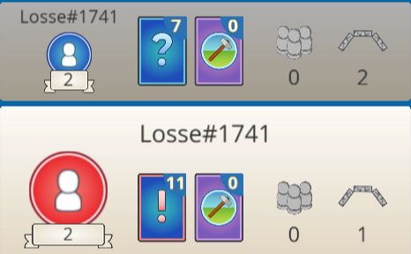
Victory points and ending the game
Figure 1: #5
Figure 2: #5

Slide 12
OTHER SOLUTIONS
Rule-based bots
Search-based methods
Supervised Learning

Slide 13
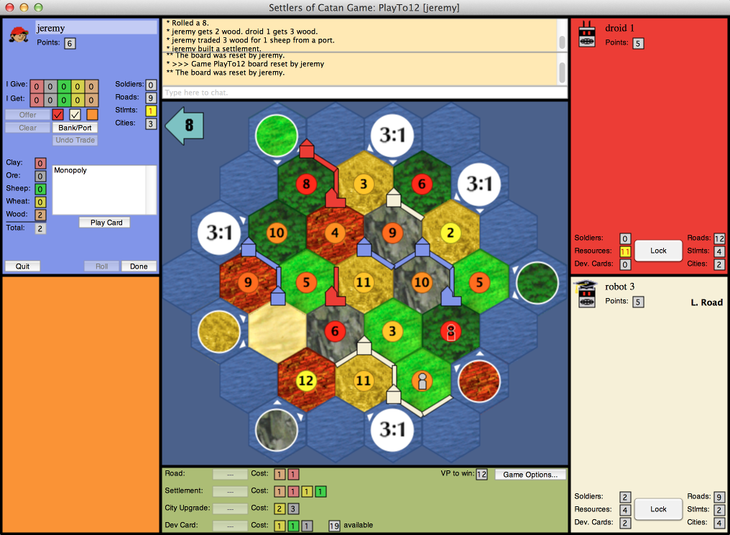
Rule Based Bots
JAVA GUI (JSettlers2)
Although up to date, not adaptable
Figure 1: #6

Slide 14
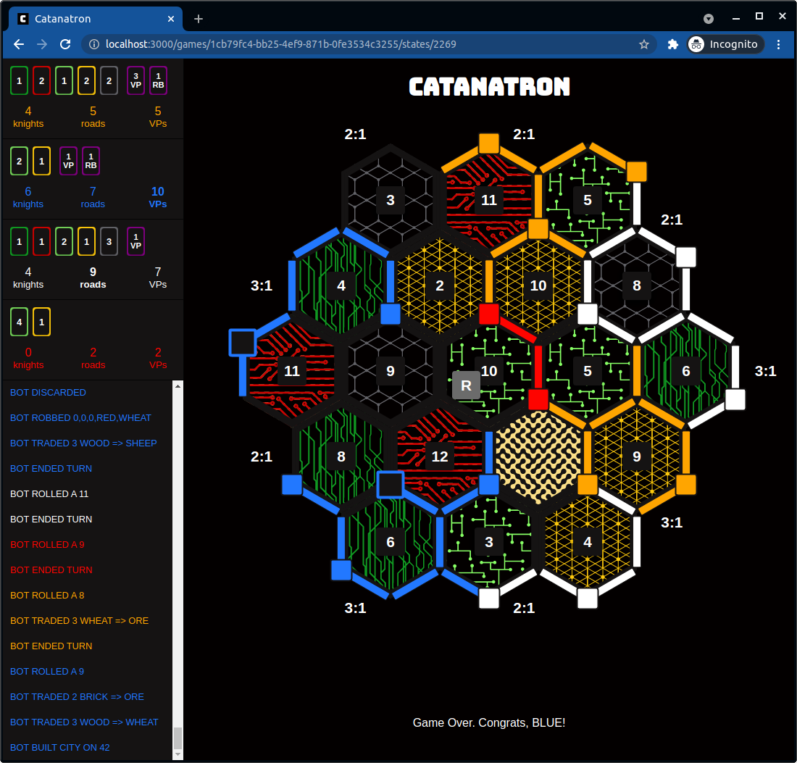
Search Based Methods
Implementations utilize Alpha-Beta, as well as A-Star
High computing cost
Non-deterministic game (dice rolls)
Figure 1: #7

Slide 15
Supervised Learning
Not viable for Catan because of lack of datasets
Catanatron implements this somewhat, but a dependence on it can lead to overfitting

Slide 16
Impact
Advances in a field that has seen no recent updates (Most popular results haven’t been updated in 5 years)
Progress research into game theory
Allow people to play against stronger and smarter Catan bots to help them train and learn

Slide 17
What is Reinforcement Learning?
Reinforcement learning is a framework where an agent:
Observes a state
Takes an action
Receives a reward
Transitions to a new state
Uses that experience to improve future decisions

Slide 18

PACKAGES
Used to host the environment of the game and get the data from it.
Used for most scientific calculations on python, and from C++ (which makes it faster)
NumPy

Slide 19
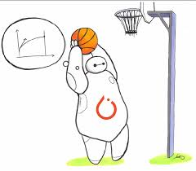
PACKAGES
Stable_baselines3
Arguably the most important package. Creates the reinforcement learning behind the robot, and allows for simple implementation and customization of variables (such as reward, and training time)

Slide 20

ENVIRONMENT BREAKDOWN
The environment is from the creators of catanatron (https://docs.catanatron.com/) and their environment and bots are going to be used to train our model.

Slide 21
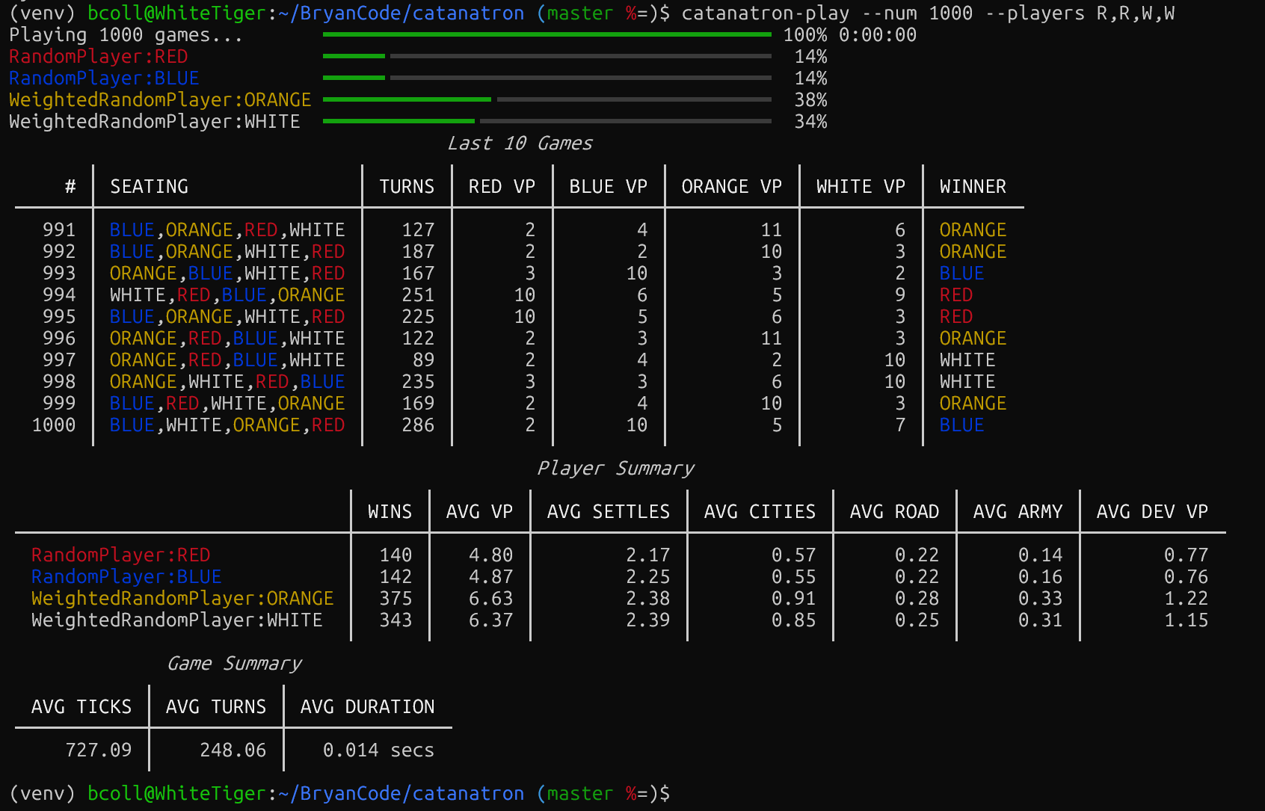
ENVIRONMENT BREAKDOWN
Reasoning for use:
Backend with gymnasium
Allows integration of stable_baselines3 to train the model with their simulation ability
In the future, we can run testing sessions with their different bots, as shown to the left

Slide 22
METHODS
The process begins by passing the current environment state to the model
The state represents the full Catan game situation:
Board configuration
Player resources and victory points
Turn and action constraints
Stable-Baselines3 automatically:
Converts the environment output into a readable format
Normalizes and flattens the observation if needed
This encoded state becomes the input vector to the neural network

Slide 23
THE REINFORCEMENT BACKEND
The model uses MaskablePPO
The neural network consists of:
Shared hidden layers or Neural Network weights
Two separate outputs:
Move valuation (higher score means better move)
Game state (predicts a win, or a loss -1 or 1)
The “Mask” portion of the PPO removes the illegal moves from the move valuations

Slide 24
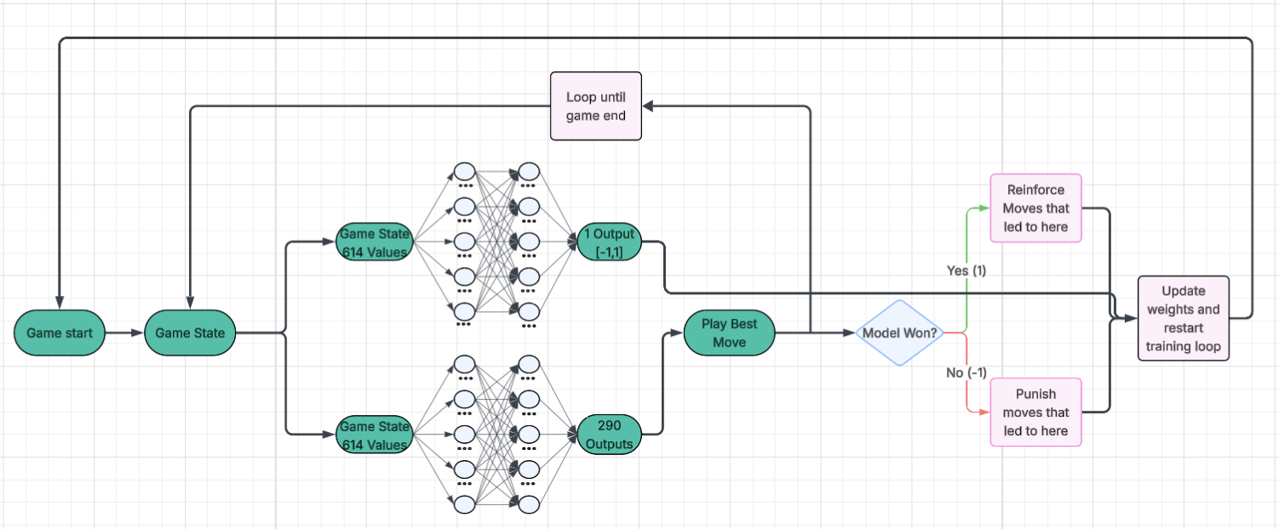
OVERALL ARCHITECTURE

Slide 25
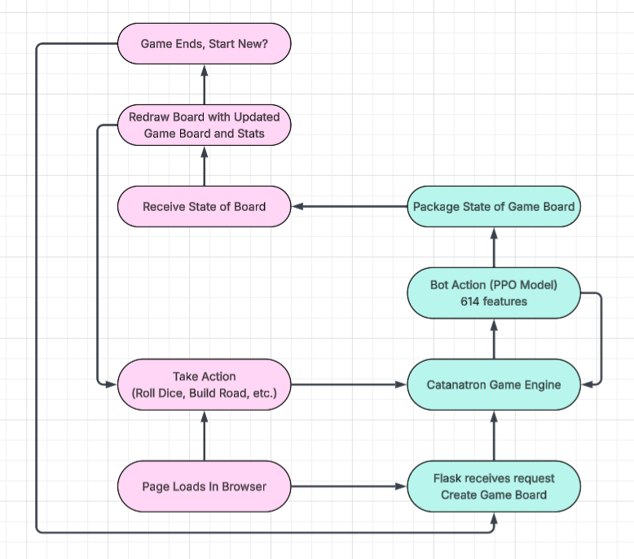
Catan Website

Slide 26
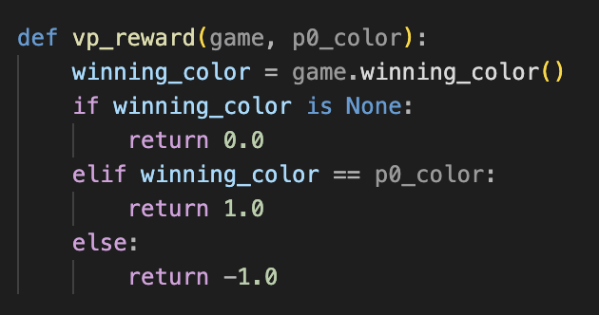
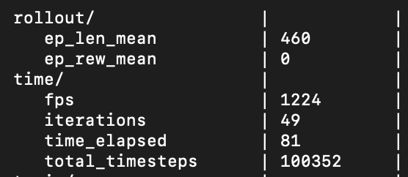
BASIC REWARD FUNCTION
By training the model, currently with this simple reward function we have seen 0 improvement (and just noise) with minimal training
After 81 seconds of training the model seems to be equivalent to randomly choosing a move to play

Slide 27
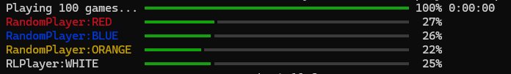
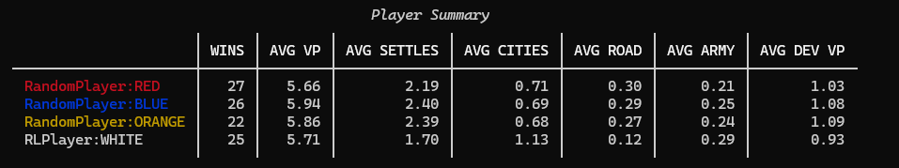
MODEL TESTING
Model after 5 million steps (1 hour of training) over 100 games
No significant change between random

Slide 28

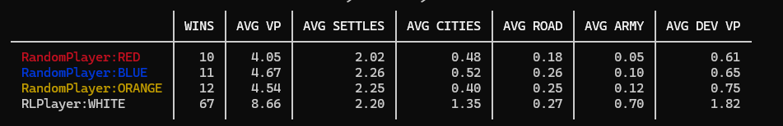
MODEL TESTING
Model after 20 million steps (4 hours of training) over 100 games

Slide 29
FAILED REWARD FUNCTIONS
Attempt at LongTermMemory
Kept track of
public victory points, actual victory points, whether they have longest road, and whether they have largest army
Mid-game reward
Each step subracts reward by 0.01
+ 1.5 times change in VP
+ 0.75 plus for longest road (-0.75 for losing it)
+ 0.75 plus for largest army (0.75 for losing it)
± 20 points for losing/winning

Slide 30
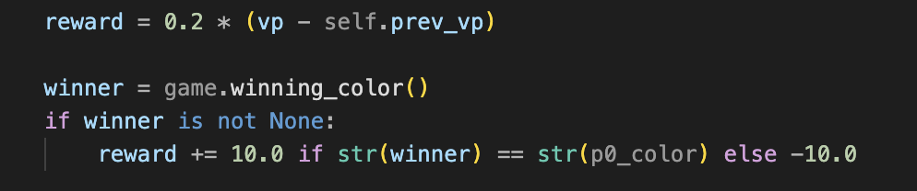
FAILED REWARD FUNCTIONS
Third attempt, after failure with a complex reward function (
+ 0.2 times change in VP
Win adds 10 points
Loss subracts 10 points

Slide 31
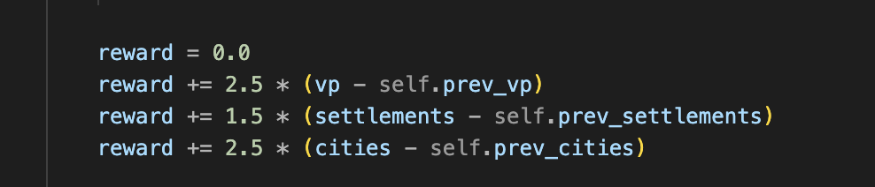
IMPROVED REWARD FUNCTION
Win → + 10
Loss → - 10
Other rewards for during games
+2.5 times change in VP
+1.5 times change in settlements
+2.5 times change in cities
Overall this new reward function is trying to keep the code relatively simple while keeping functionality

Slide 32
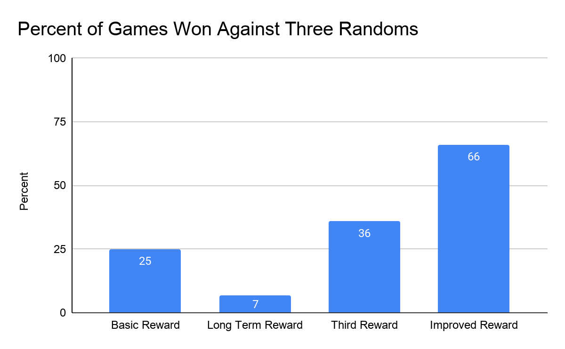
COMPARING REWARD FUNCTIONS
Trials done with a baseline of 1 hour of training with 100 games against three randoms.

Slide 33
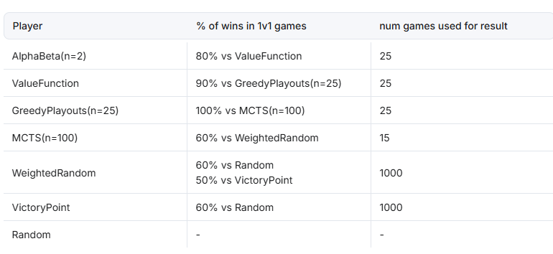
MODEL TRAINING/TESTING WITH HARDER MODELS
AI Leaderboard given by Catanatron

Slide 34
THE TRAINING PROCESS
Trained against 3 random bots for 10 million steps (about 2 hours)
Trained against 1 weighted random bot, and 2 random bots for 6 million steps (about 1 hour)
Trained against 3 weighted random bots for 2 million steps (<1 hour)
Trained against 1 ValueFunction bot and 2 weighted random bots for 2 million steps (about 4 hours)
Trained against 2 ValueFunction bots and 1 weighted random bot for 2 million steps (about 4 hours)

Slide 35
THE TRAINING PROCESS
Why does ValueFunction training take so long?
Since we ask that bot to evaluate its board and make a move at every single turn, the computation required heavily slows down training.
Compared to WeightedRandom and Random, its 5 times slower per ValueFunction bot when training against it.

Slide 36
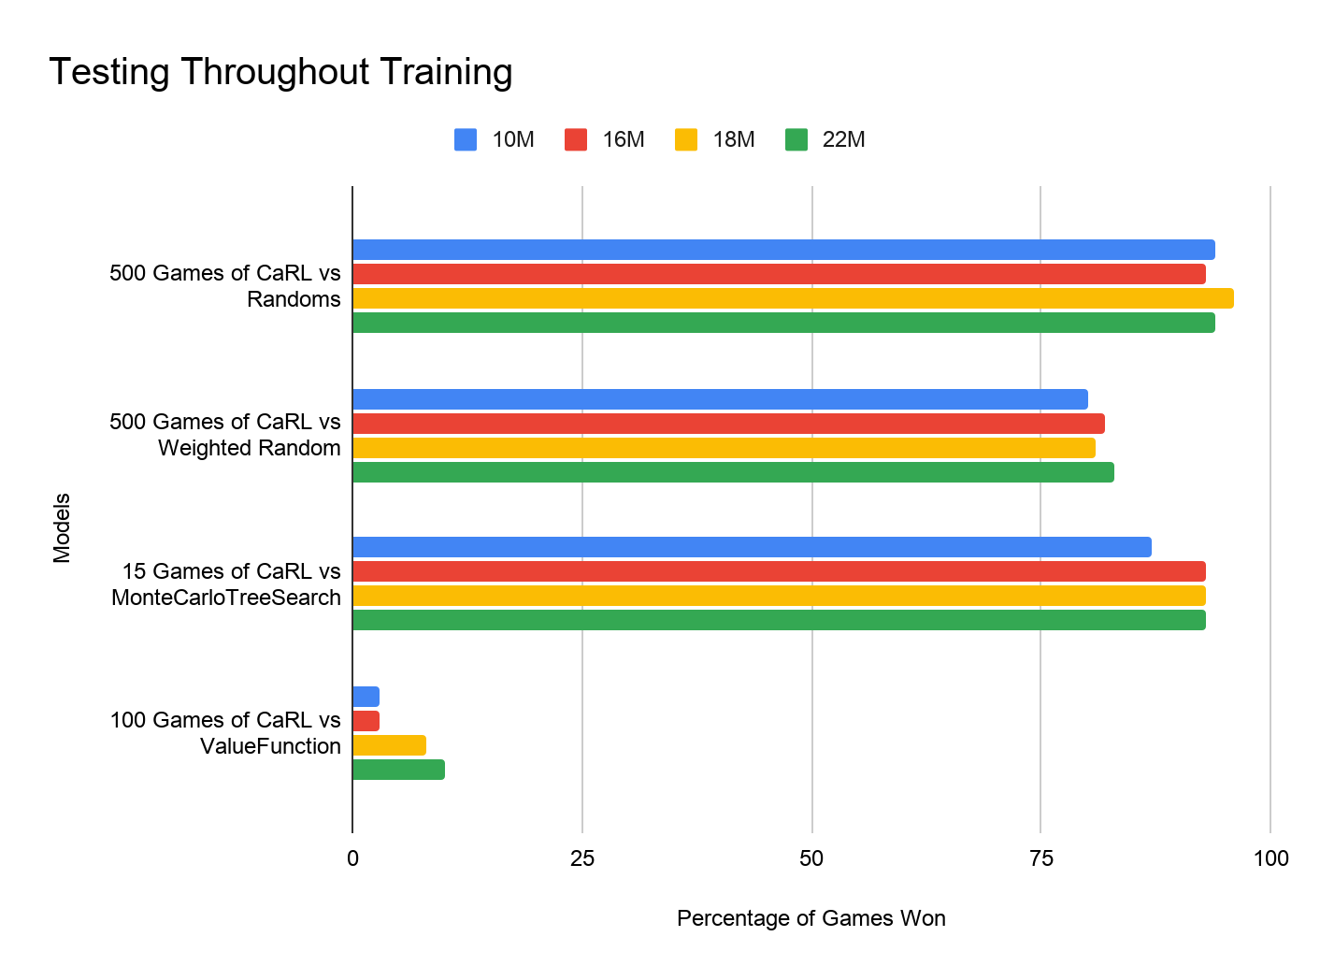
TESTING THE MODEL THROUGH TRAINING

Slide 37
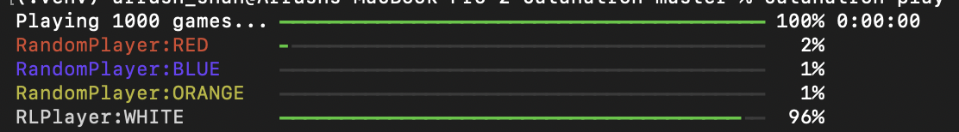
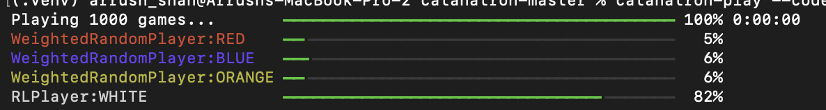
TESTING THE MODEL
1000 Games against Random.
1000 games against WeightedRandom

Slide 38
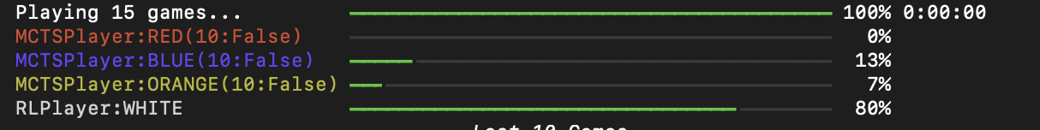
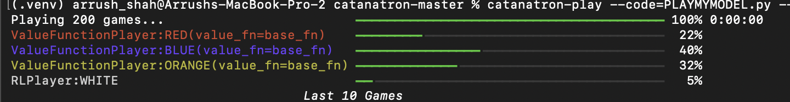
TESTING THE MODEL
Against MCTS. (given to have a 60% winrate against WeightedRandom).
Against ValueFunction (given to have a ~100% winrate against MCTS)

Slide 39

WEBSITE
DEMO

Slide 40
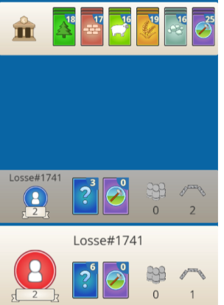
Why IS Ours BETTER?
Our model is significantly faster to evaluate a move compared to stronger models, like MonteCarloTreeSearch and ValueFunction
Our model prioritizes cities, which give double the win points over settlements, allowing for easier wins

Slide 41
Limitations
Training the model
Training takes a long time
Opponent bot speed is a huge factor in training
Website doesn’t allow for training of the model
There is no guarantee that more training will lead to linearly increasing accuracy against ValueFunction (although that is currently observed)

Slide 42
RESULTS
Reward design had a major effect on performance.
In one-hour tests against random bots:
Basic reward: 25% win rate
Long-term reward: 7% win rate
Third reward: 36% win rate
Improved reward: 66% win rate
Longer training improved performance against simple bots.
Final model performed strongly against Random, WeightedRandom, and MCTS bots.
Model won about 80% against MCTS, but only 5% against ValueFunction.
Overall, the model improved beyond random play but still struggled against stronger strategy-based bots.

Slide 43
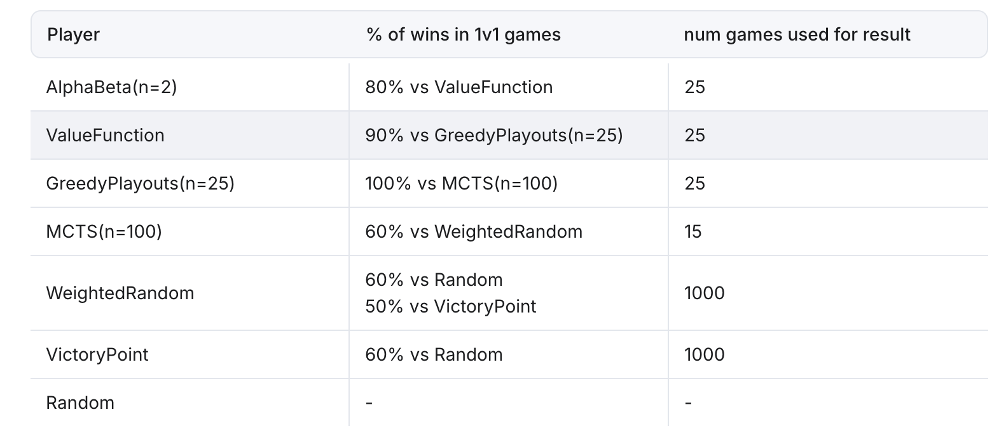
CONCLUSION AND FUTURE WORK
Our model can be placed right below ValueFunction, since it outperforms all of the below algorithms.

Slide 44
CONCLUSION AND FUTURE WORK
Our website is currently being hosted online using Render web services
Although it is hosted online, there can only be one game playing at a time
Future Work:
Train the model more on a stronger setup to speed up training time
Implement Trading with the opponent instead of just the bank

Slide 45
REFERENCES
https://settlers-rl.github.io/
https://github.com/ikostrikov/pytorch-a2c-ppo-acktr-gail
https://github.com/pytorch/rl
https://github.com/henrycharlesworth/settlers_of_catan_RL
https://colonist.io
https://github.com/jdmonin/JSettlers2
https://github.com/bcollazo/catanatron
https://docs.pytorch.org/tutorials/beginner/basics/buildmodel_tutorial.html
https://github.com/bcollazo/catanatron
https://docs.catanatron.com/
https://docs.catanatron.com/using-catanatron/interactive-blocks
https://docs.catanatron.com/advanced/openapi
https://gymnasium.farama.org/
https://stable-baselines3.readthedocs.io/
https://sb3-contrib.readthedocs.io/
https://github.com/Zawiop/canatron-syslab
https://github.com/professorcool09/professorcool09.github.io

Slide 46
THANKS!

Slide 47
Q&A

